Slide 1
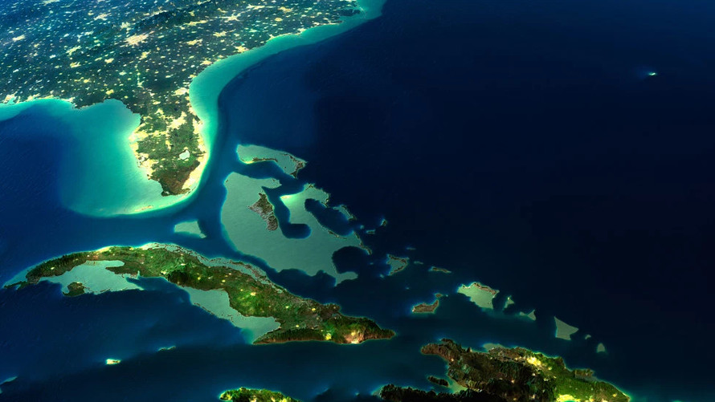
Bootcamp
Final Project
How hot is the water?

Slide 2

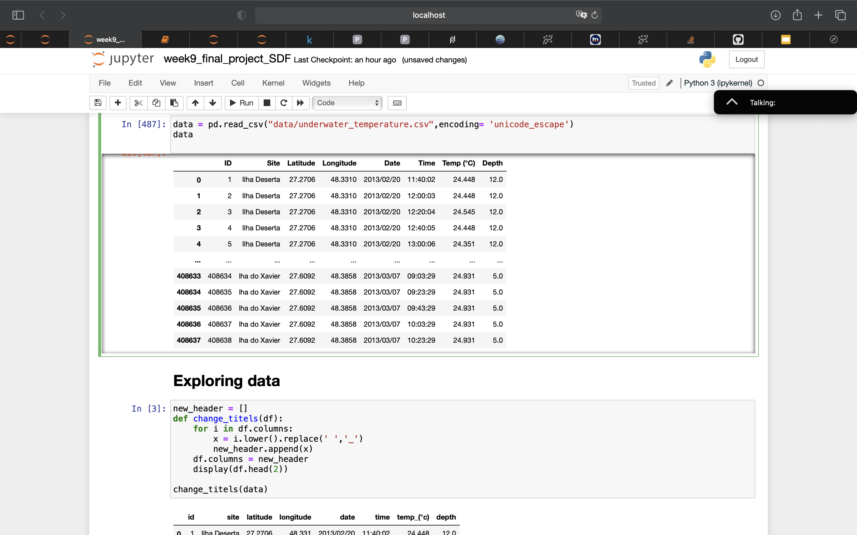
Underwater Surface Temperature Dataset
https://www.kaggle.com/datasets/shivamb/underwater-surface-temperature-dataset
Temperature records acquired every 20 min between December 2012 and July 2014.
The data loggers were installed underwater by SCUBA divers and anchored to the rocky reef with epoxy at 5 m and 12 m depth, in the islands, and at 22 m depth in the submerged reefs.
Water Temperature for analysis of sea/ocean systems, due to its relation with water quality, organisms, and hydrological events.
SEANOE. https://doi.org/10.17882/62120
Notes:
Temperature records were acquired every 20 minutes, between December 2012 and July 2014, using a HOBO Pendant® Temperature Data Logger UA-002. The data loggers were installed underwater by SCUBA divers and anchored to the rocky reef with epoxy at 5 m and 12 m depth, in the islands, and at 22 m depth in the submerged reefs. Due to equipment loss, some depths are missing for specific sites.

Slide 3
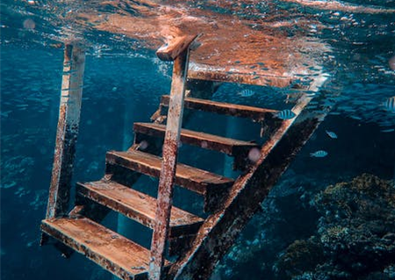
Steps:
Explore and visualize the data
Clean the data
Select the data for analysis #1
Analysis #1:
“Standard” models to predict the underwater temperature
Select the data for analysis #2
Analysis #2:
Time Series- ARIMA model to predict the underwater temperature

Slide 4
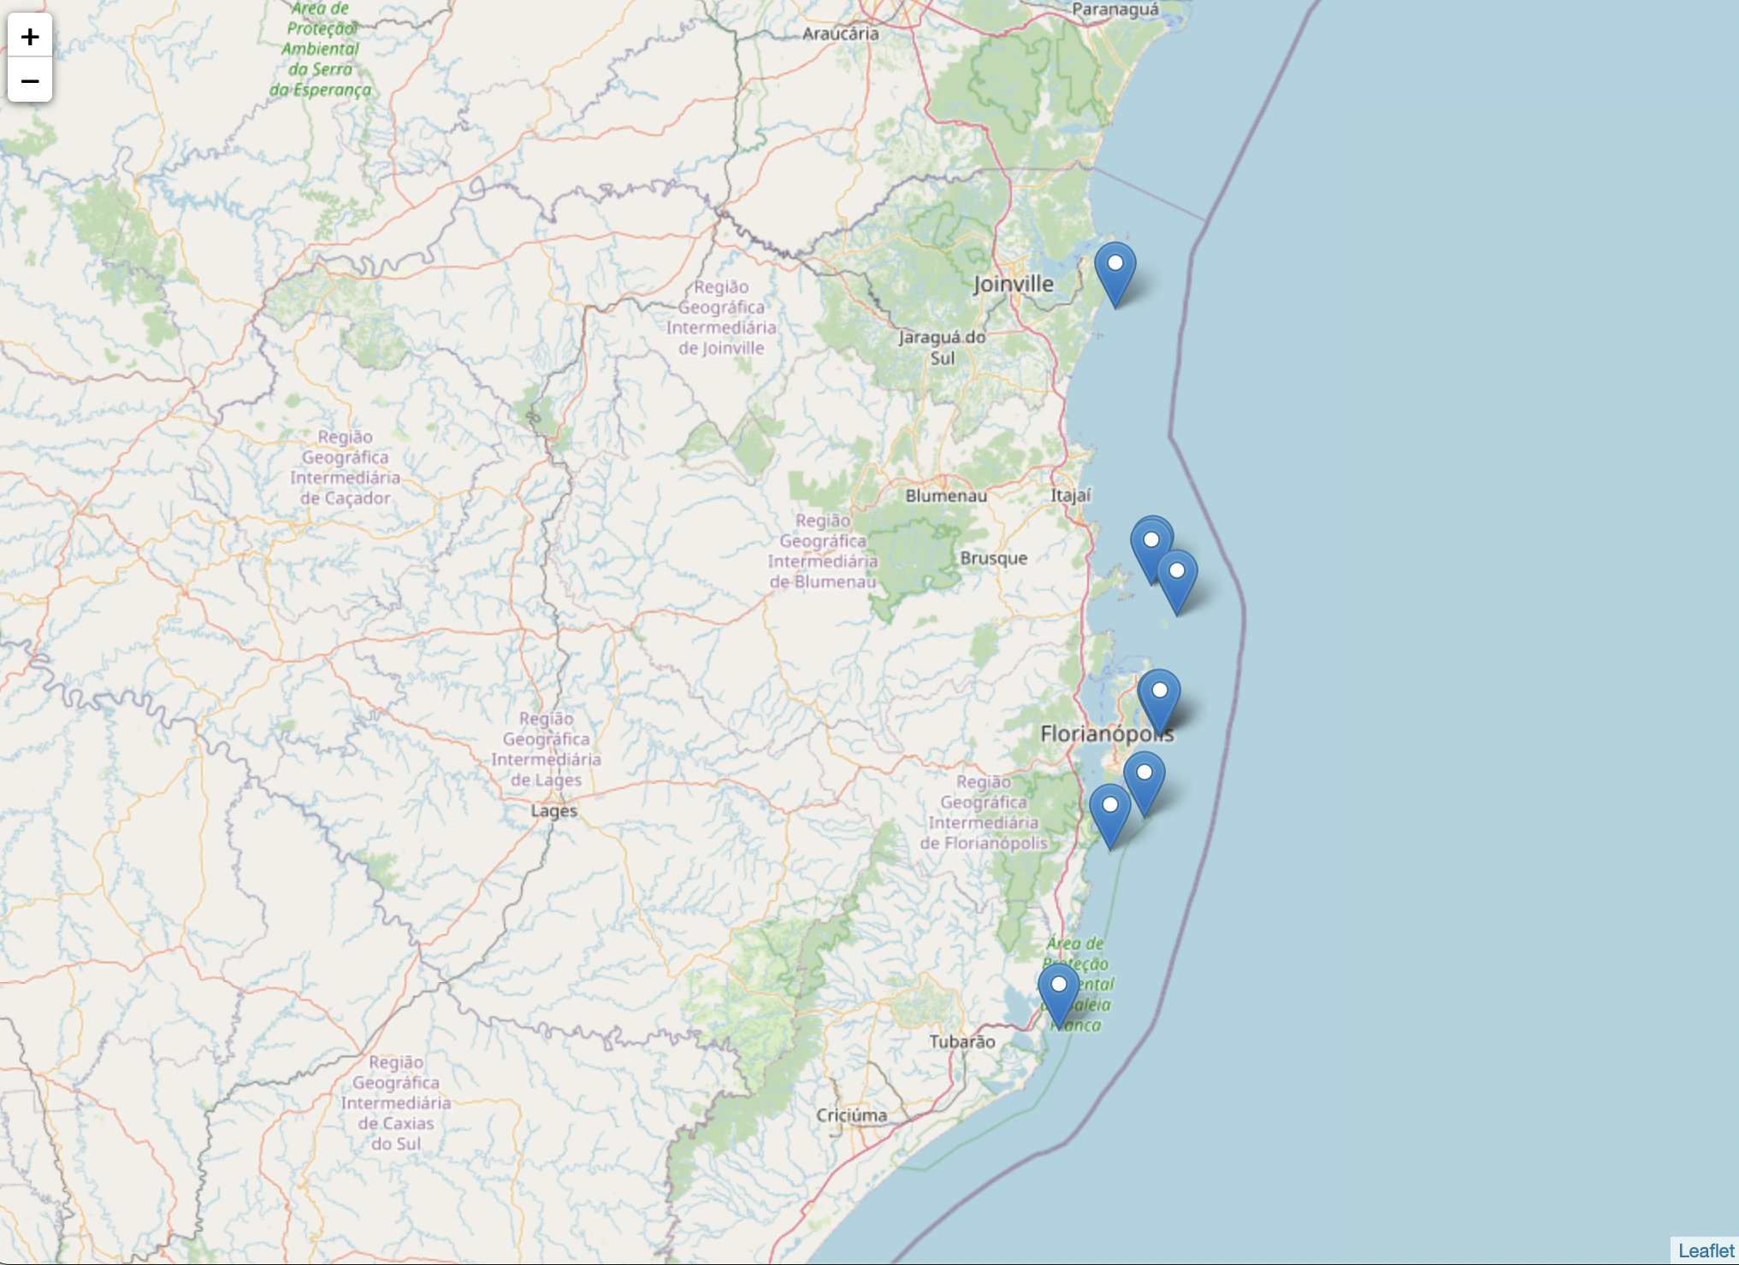
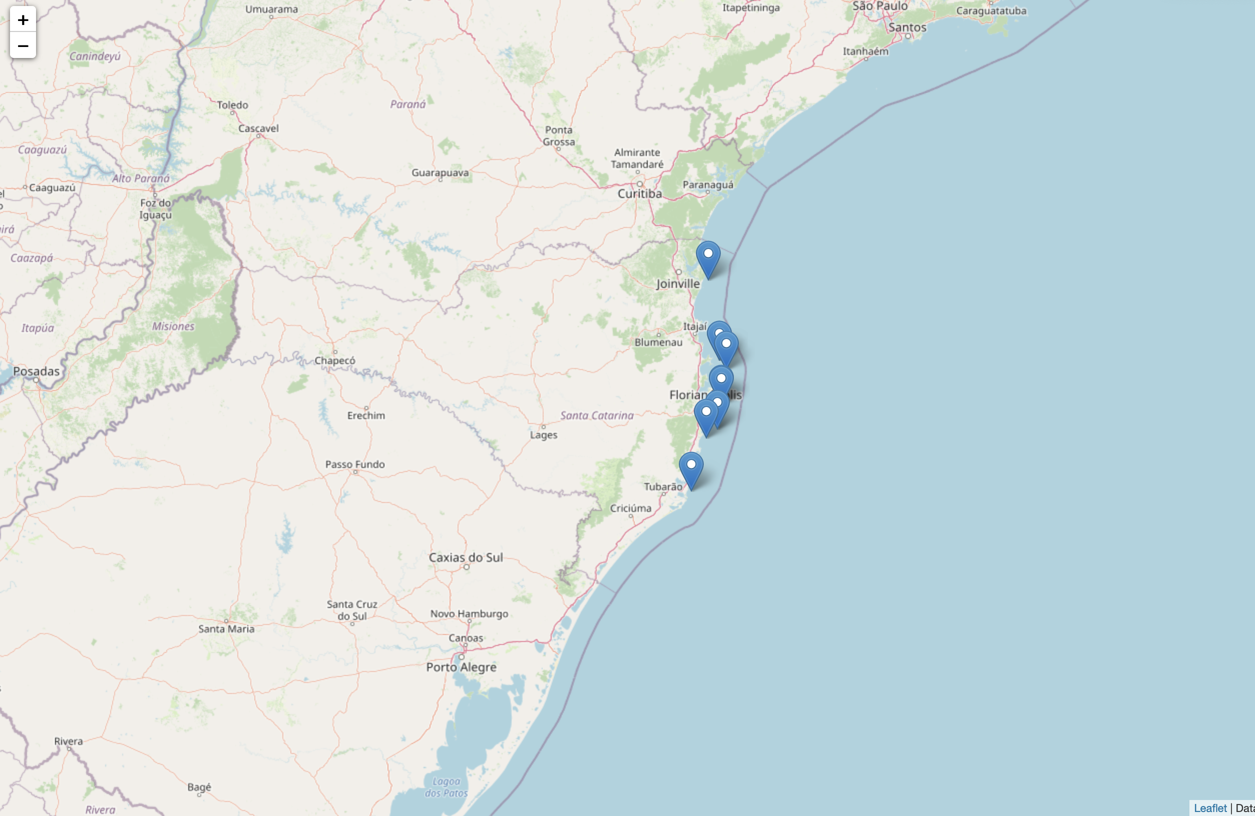
Explore and visualize the data
folium
file:///Users/silviadifra/Documents/ironhack_DA/week9/final_project/MapProject.html

Slide 5
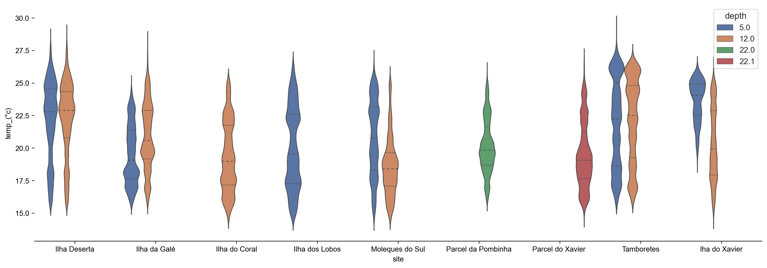
Explore and visualize the data

Slide 6
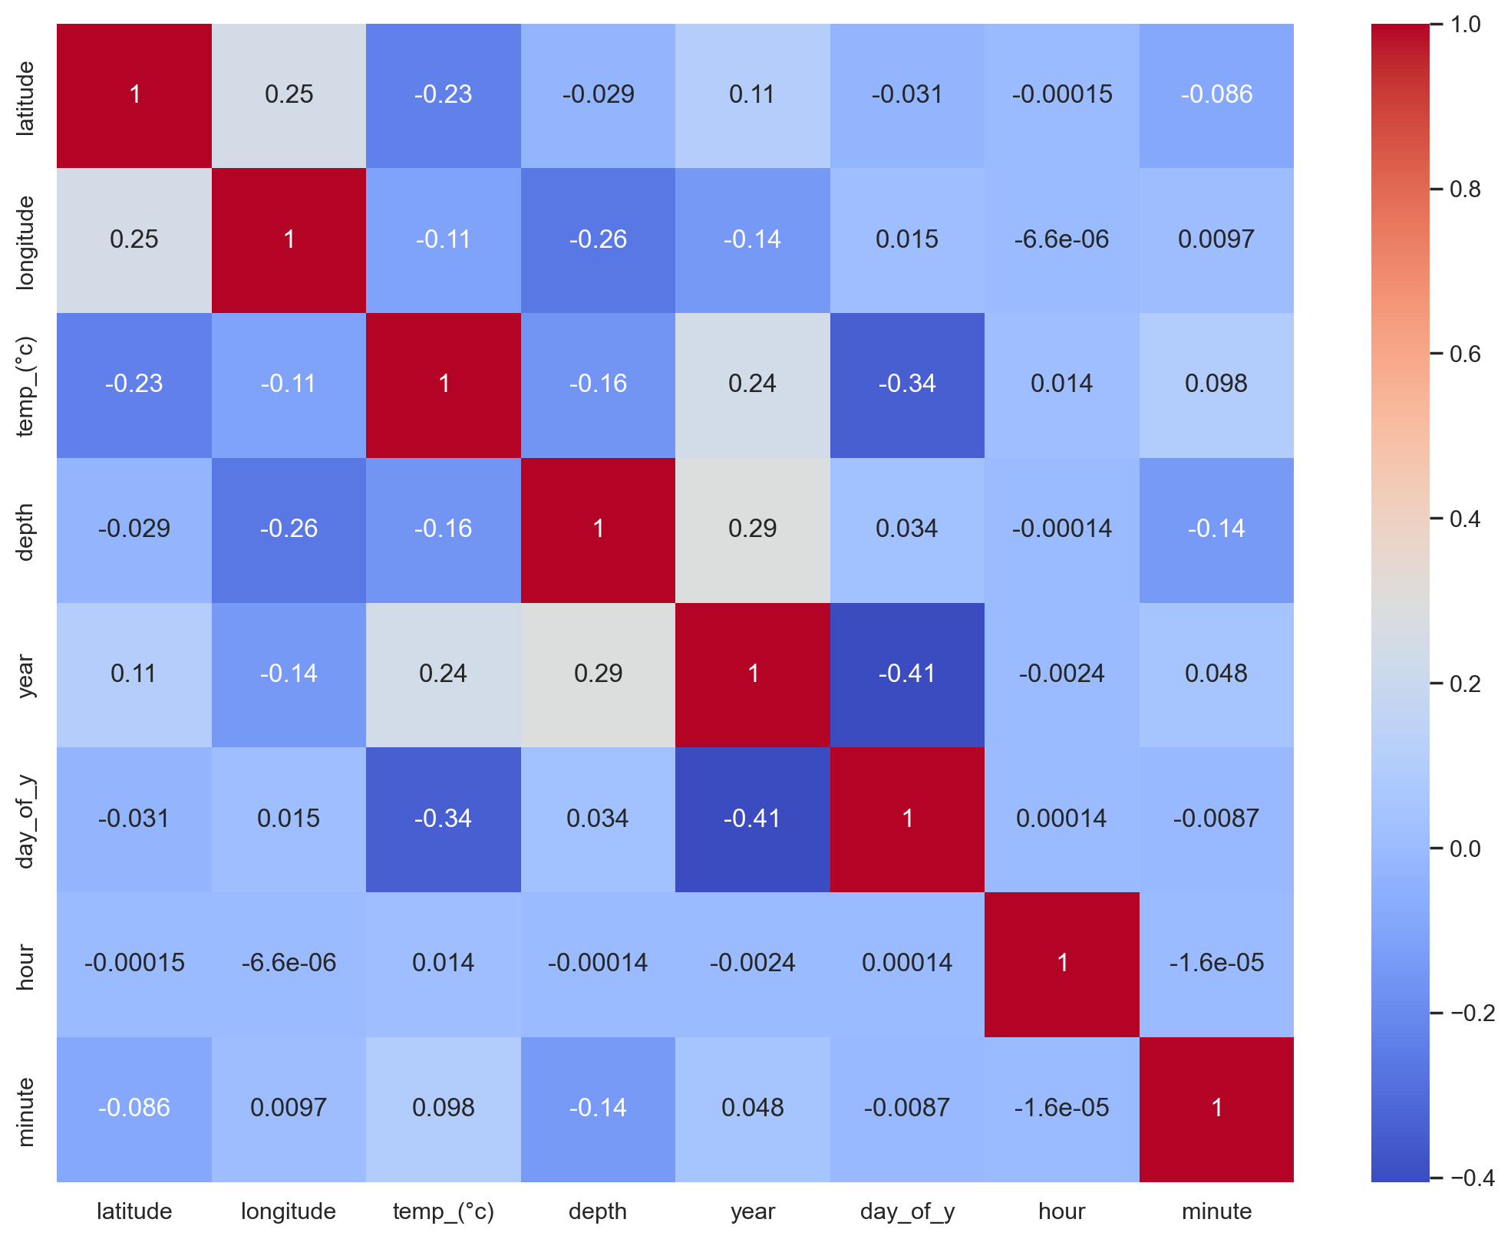
Explore and visualize the data

Slide 7
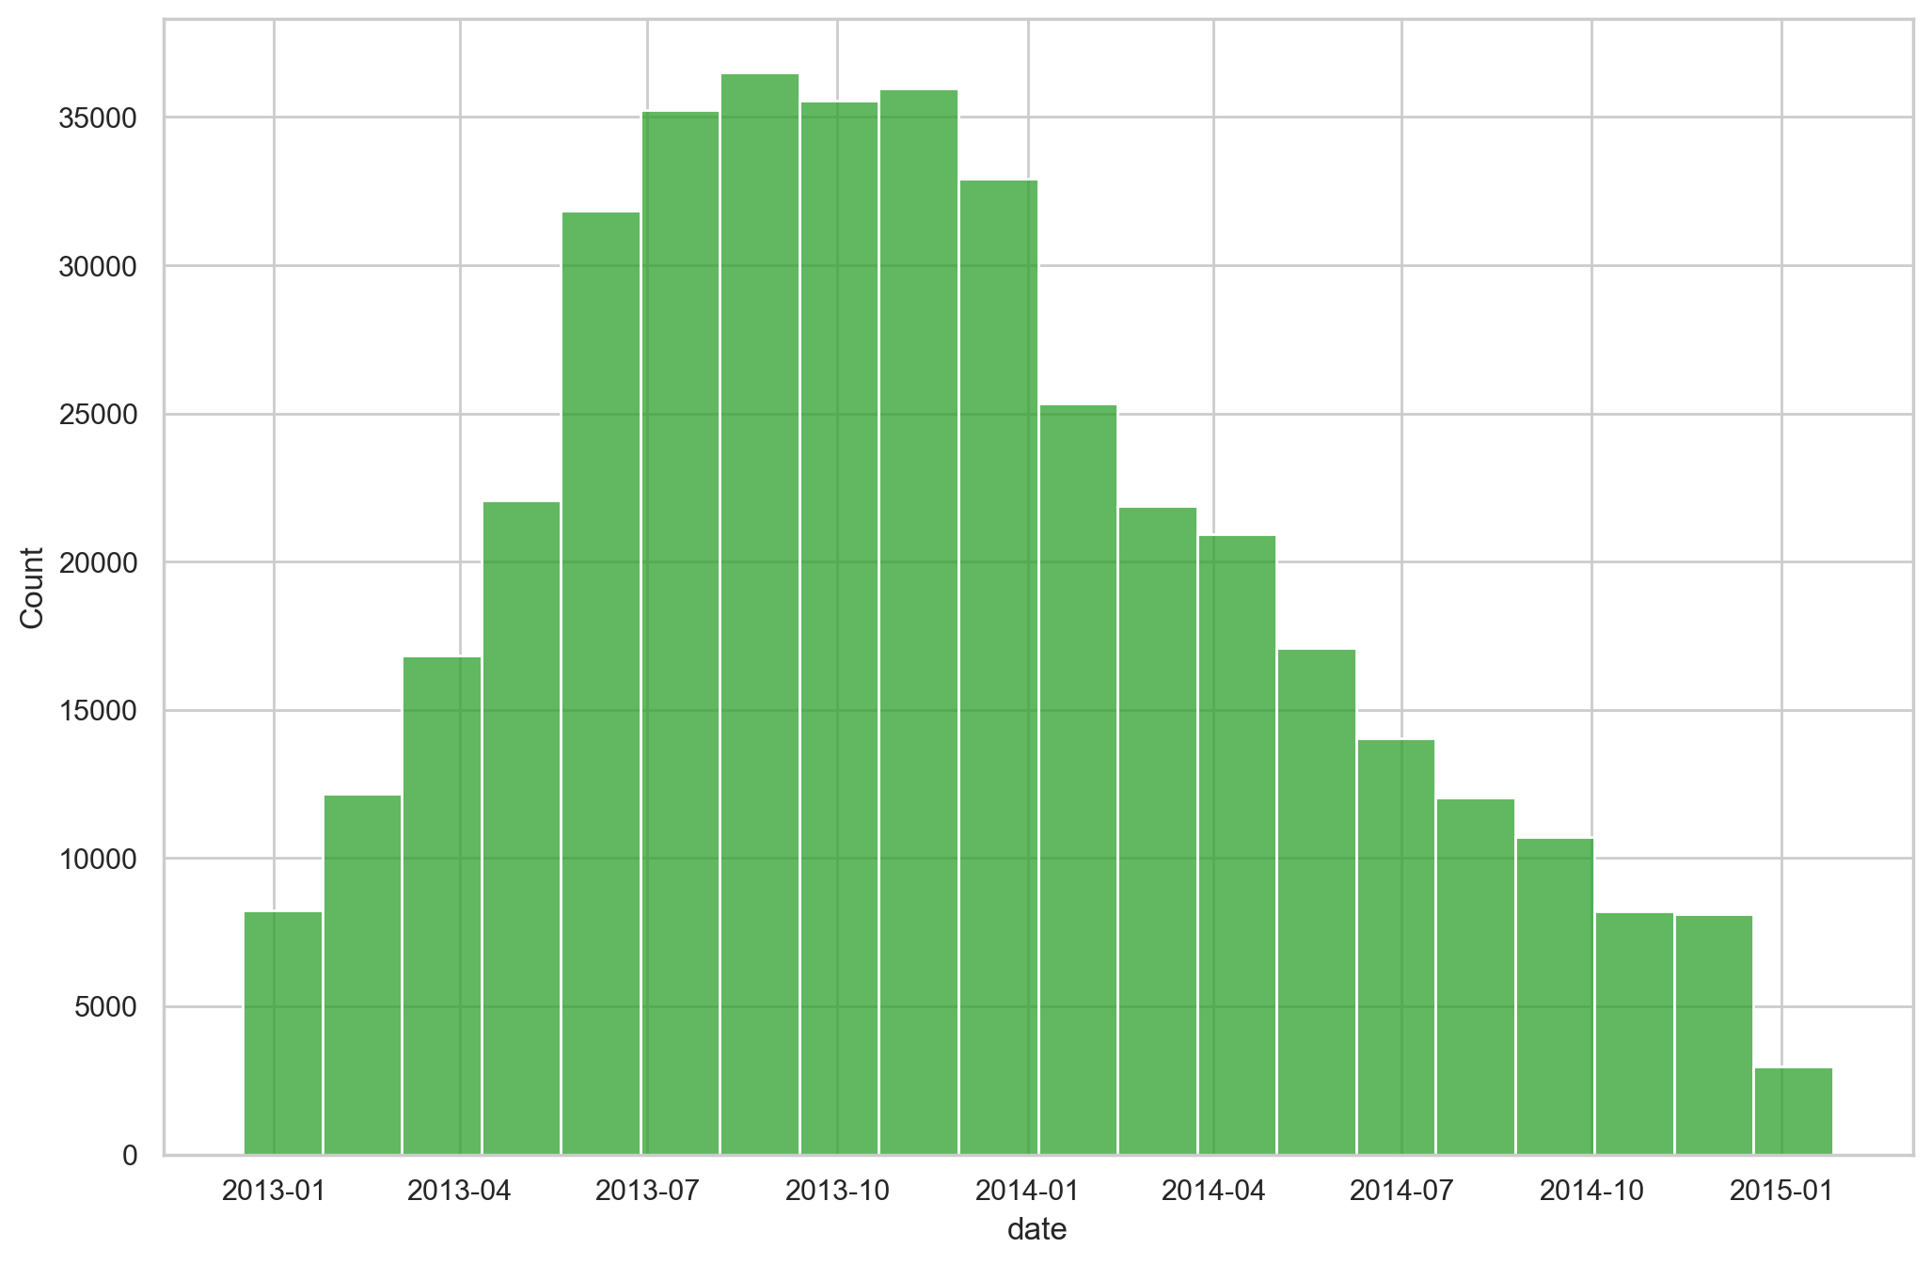
Explore and visualize the data

Slide 8
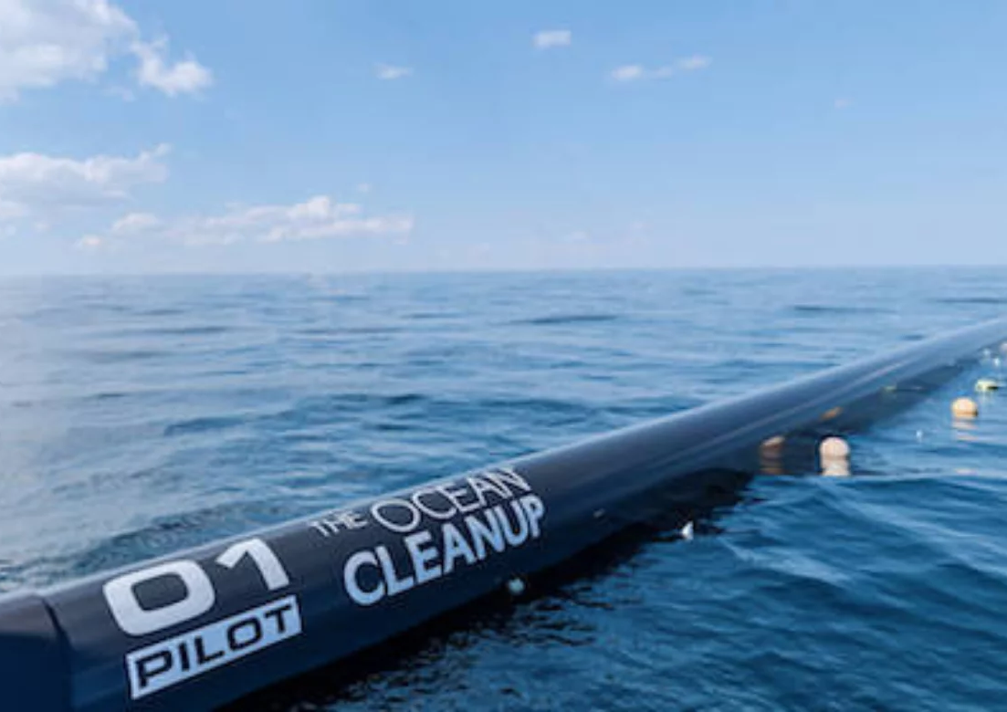
Clean the data
Change dtype in numerical or datetime
Drop NaN
Dropped some useless columns (’id’)
Data were quite clean…

Slide 9
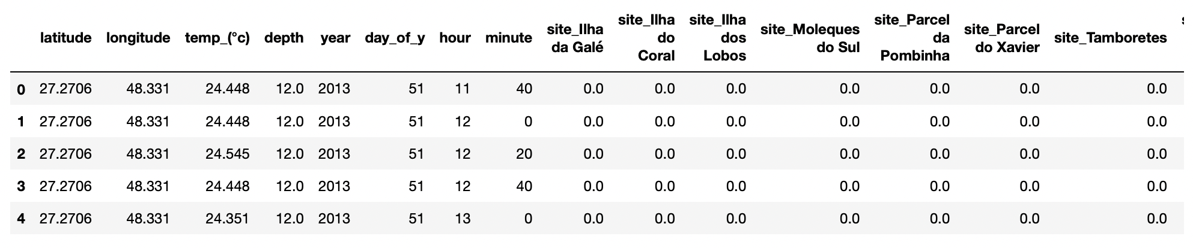
Select the data for analysis #1

Slide 10
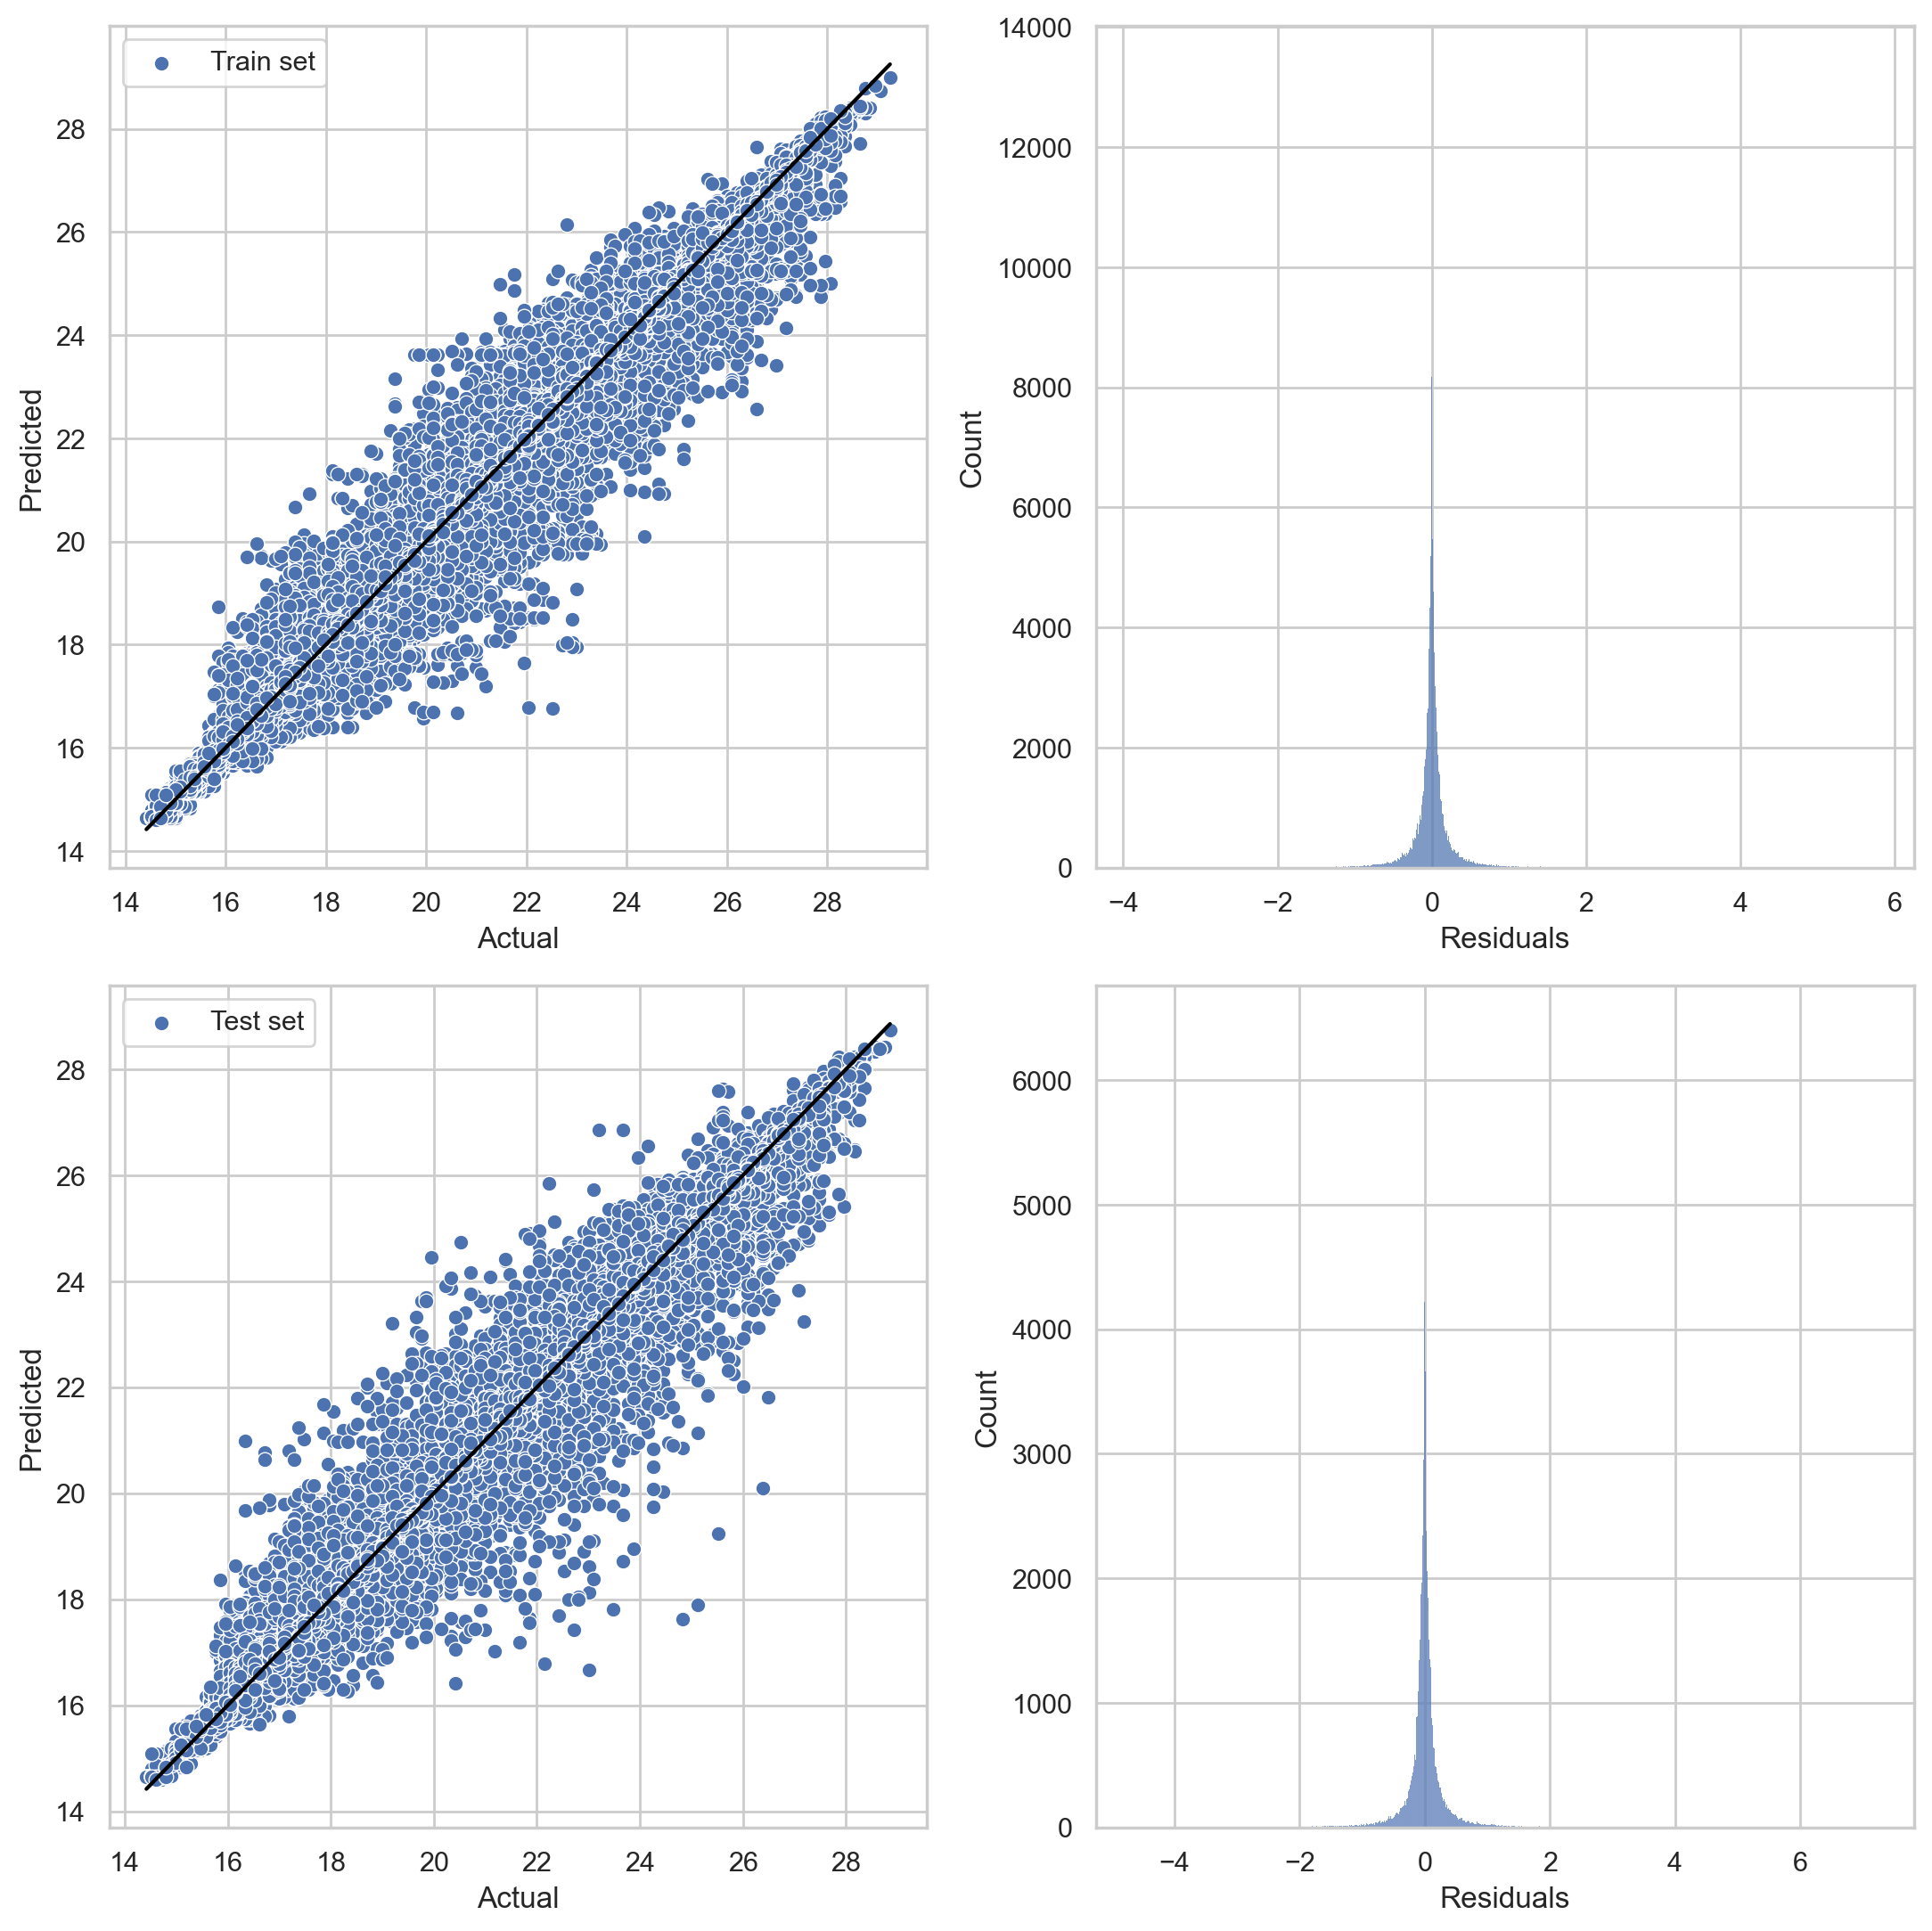
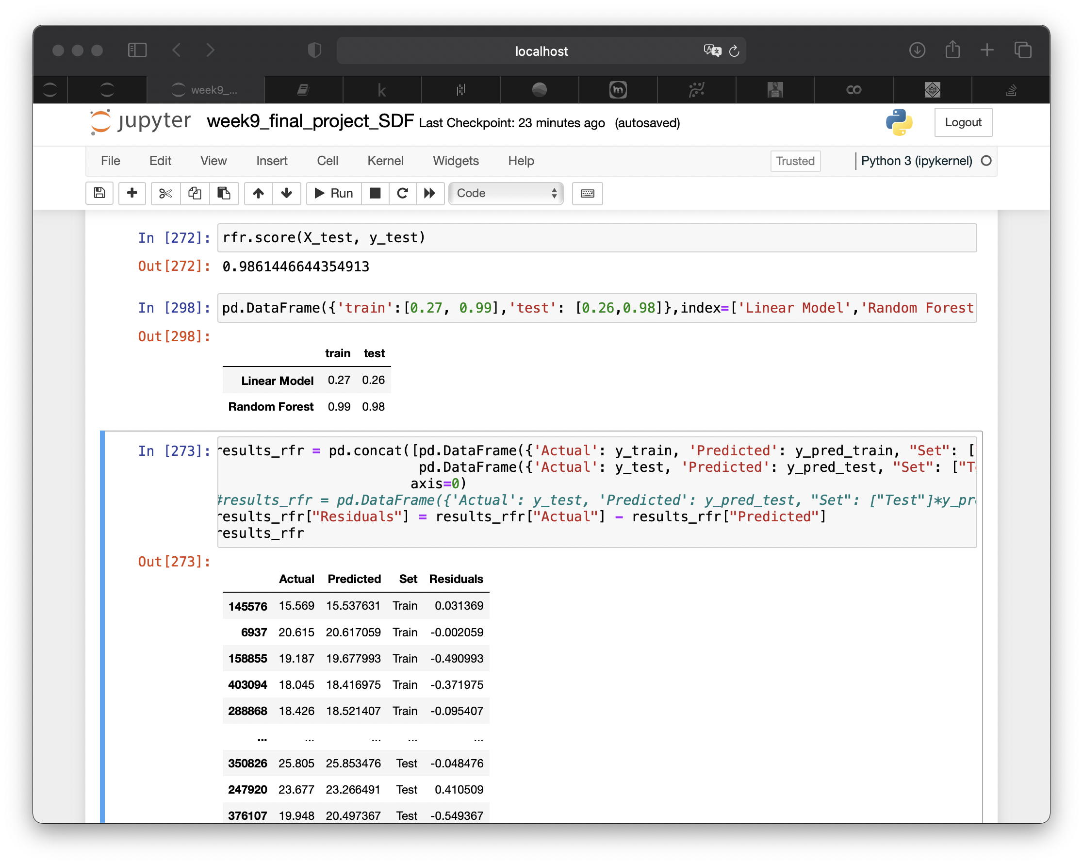
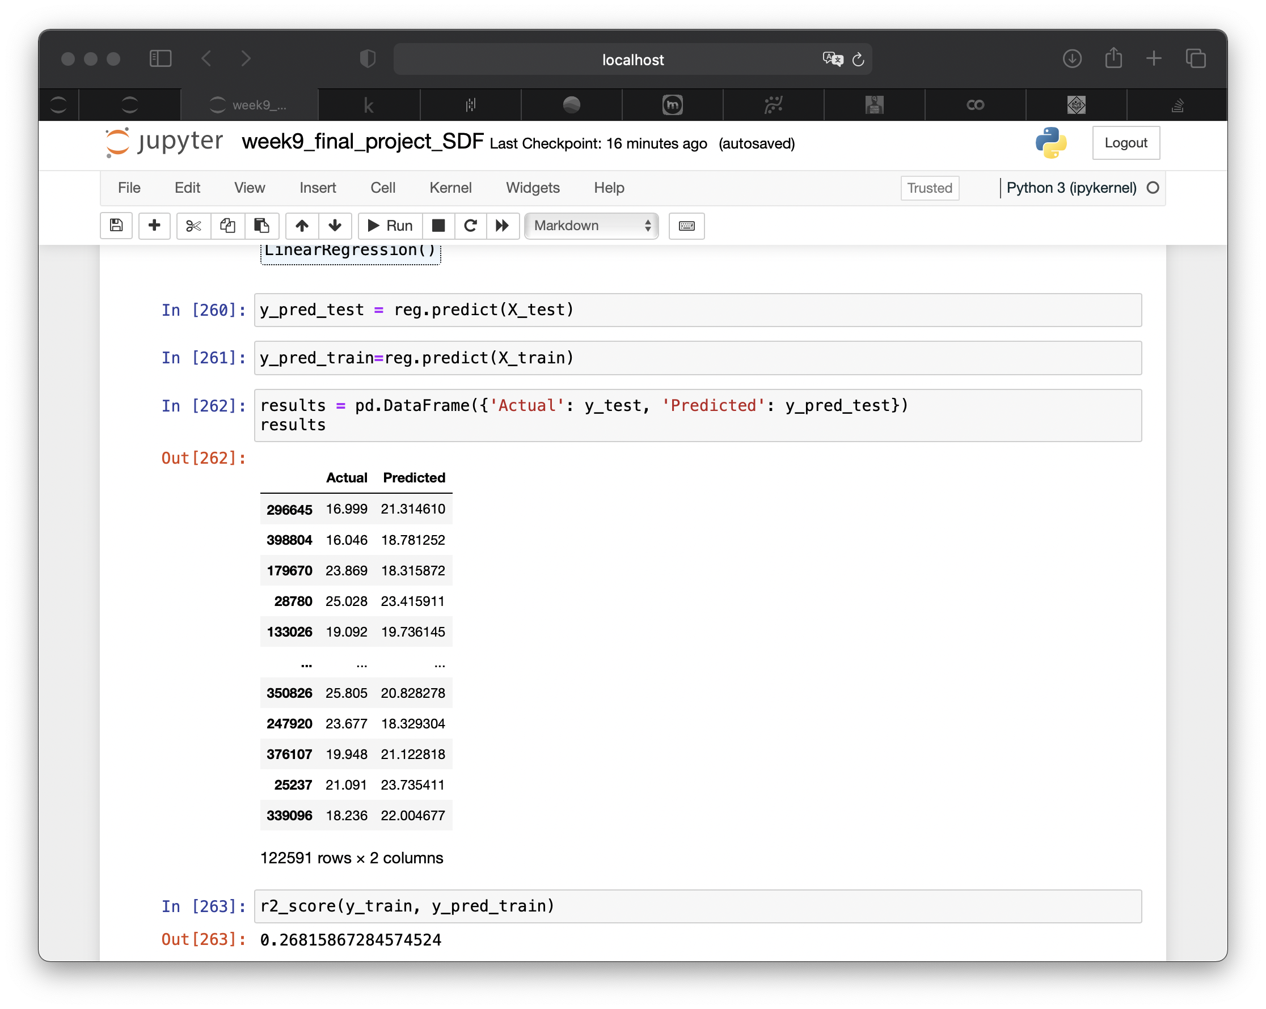
Analisis#1
Train set
Evaluating two different ML Models to predict the underwater temperature
Linera Model
Random forest
Train set

Slide 11
Select the data for analysis #2

Slide 12
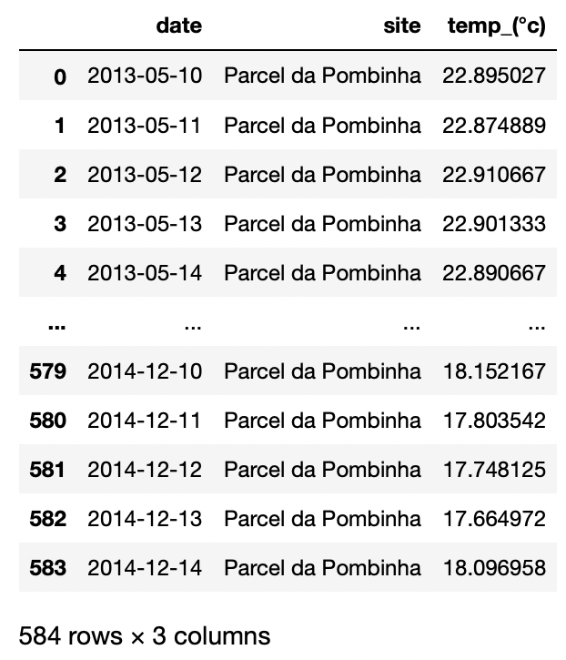
Select the data for analysis #2 Time Series
Depth= 22.0 m
Site= Parcel de Pombinha

Slide 13
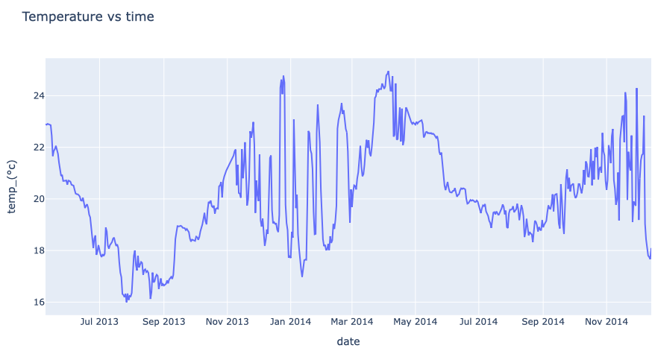
Analysis #2 = Time Series (TS)
Checking for stationarity
No stationarity
TS needs differencing = lot the the differenced series. The optimal value d is the lowest which makes the time series stationary.
Model to predict to predict the underwater temperature
MODEL=
The ARIMA(p,d,q) = AR(p) + D(d)+ MA(q) is a model which uses the original TS with “d” differences.

Slide 14
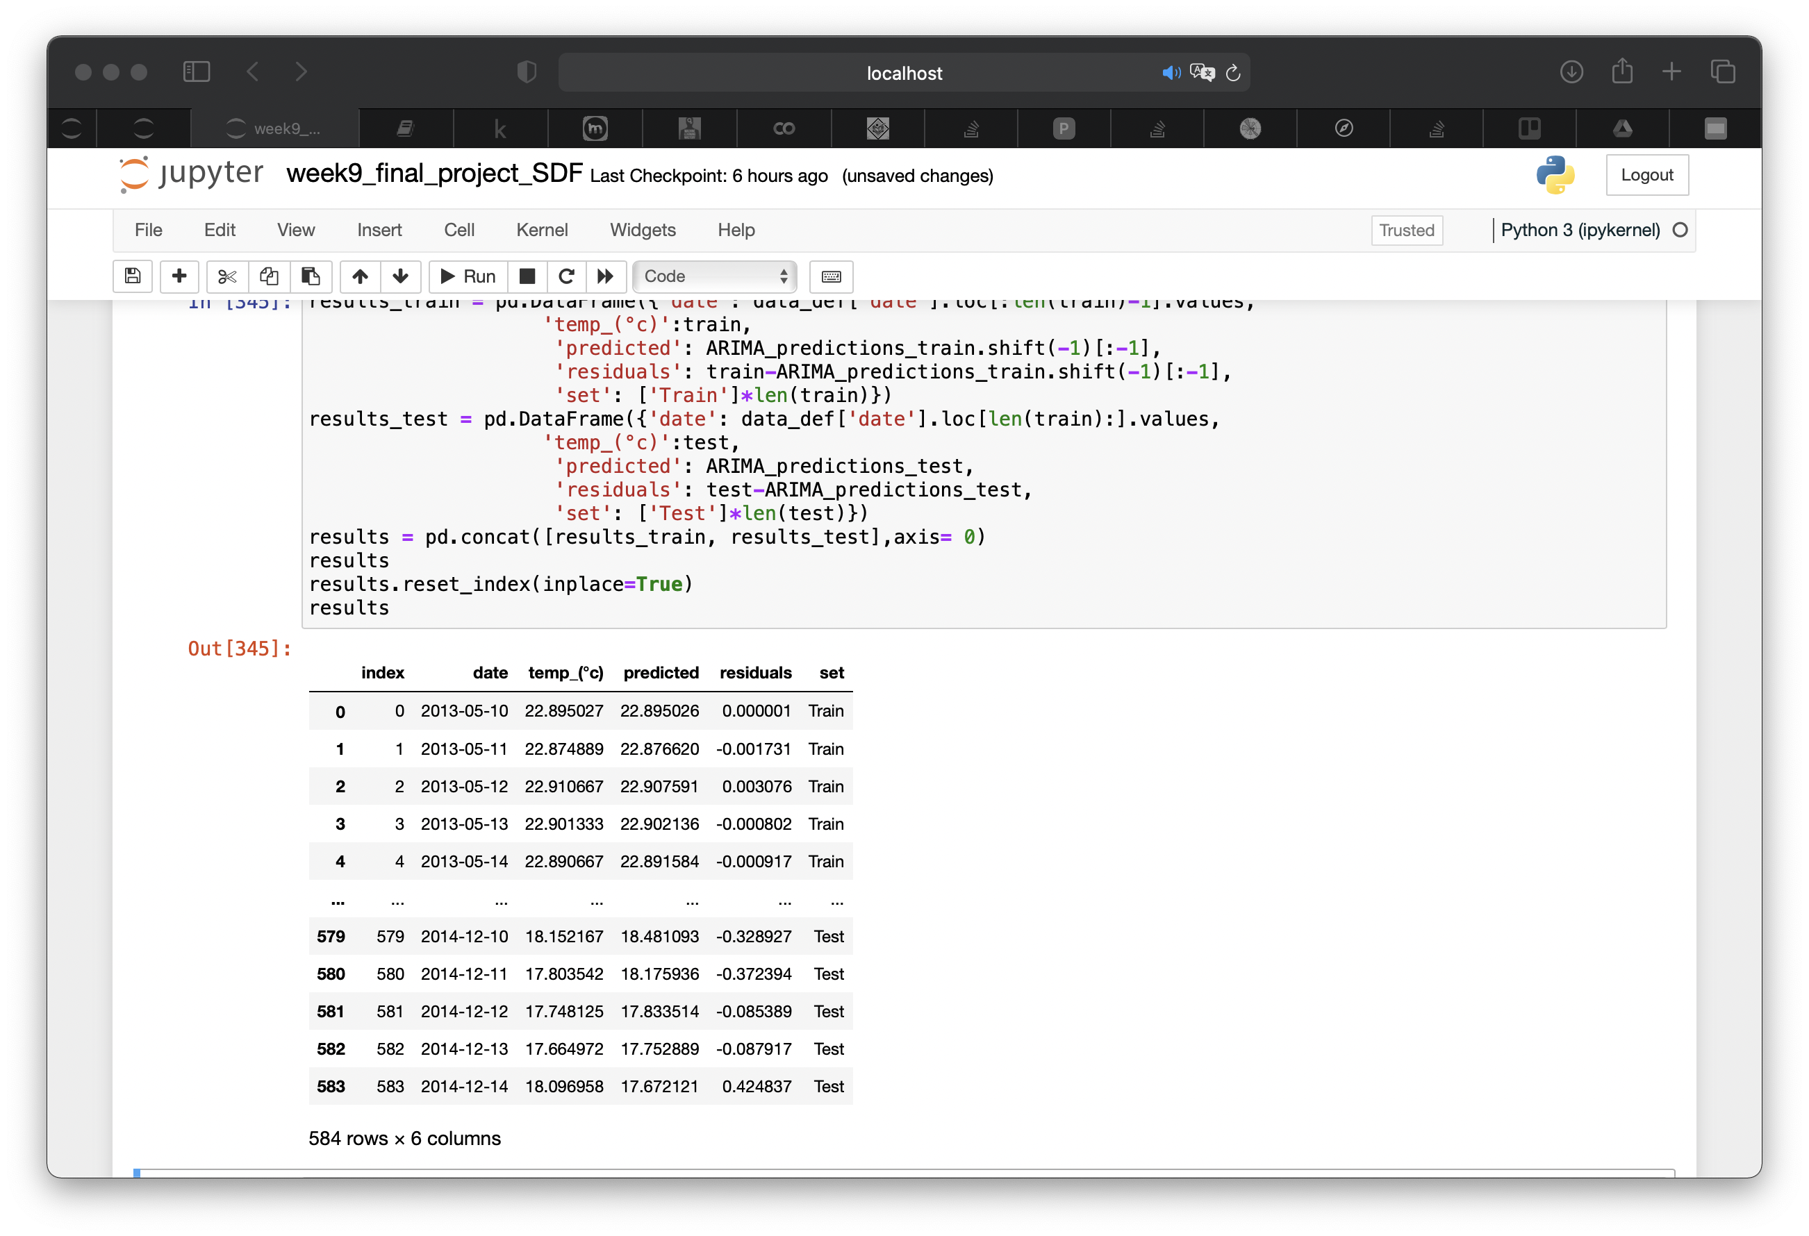
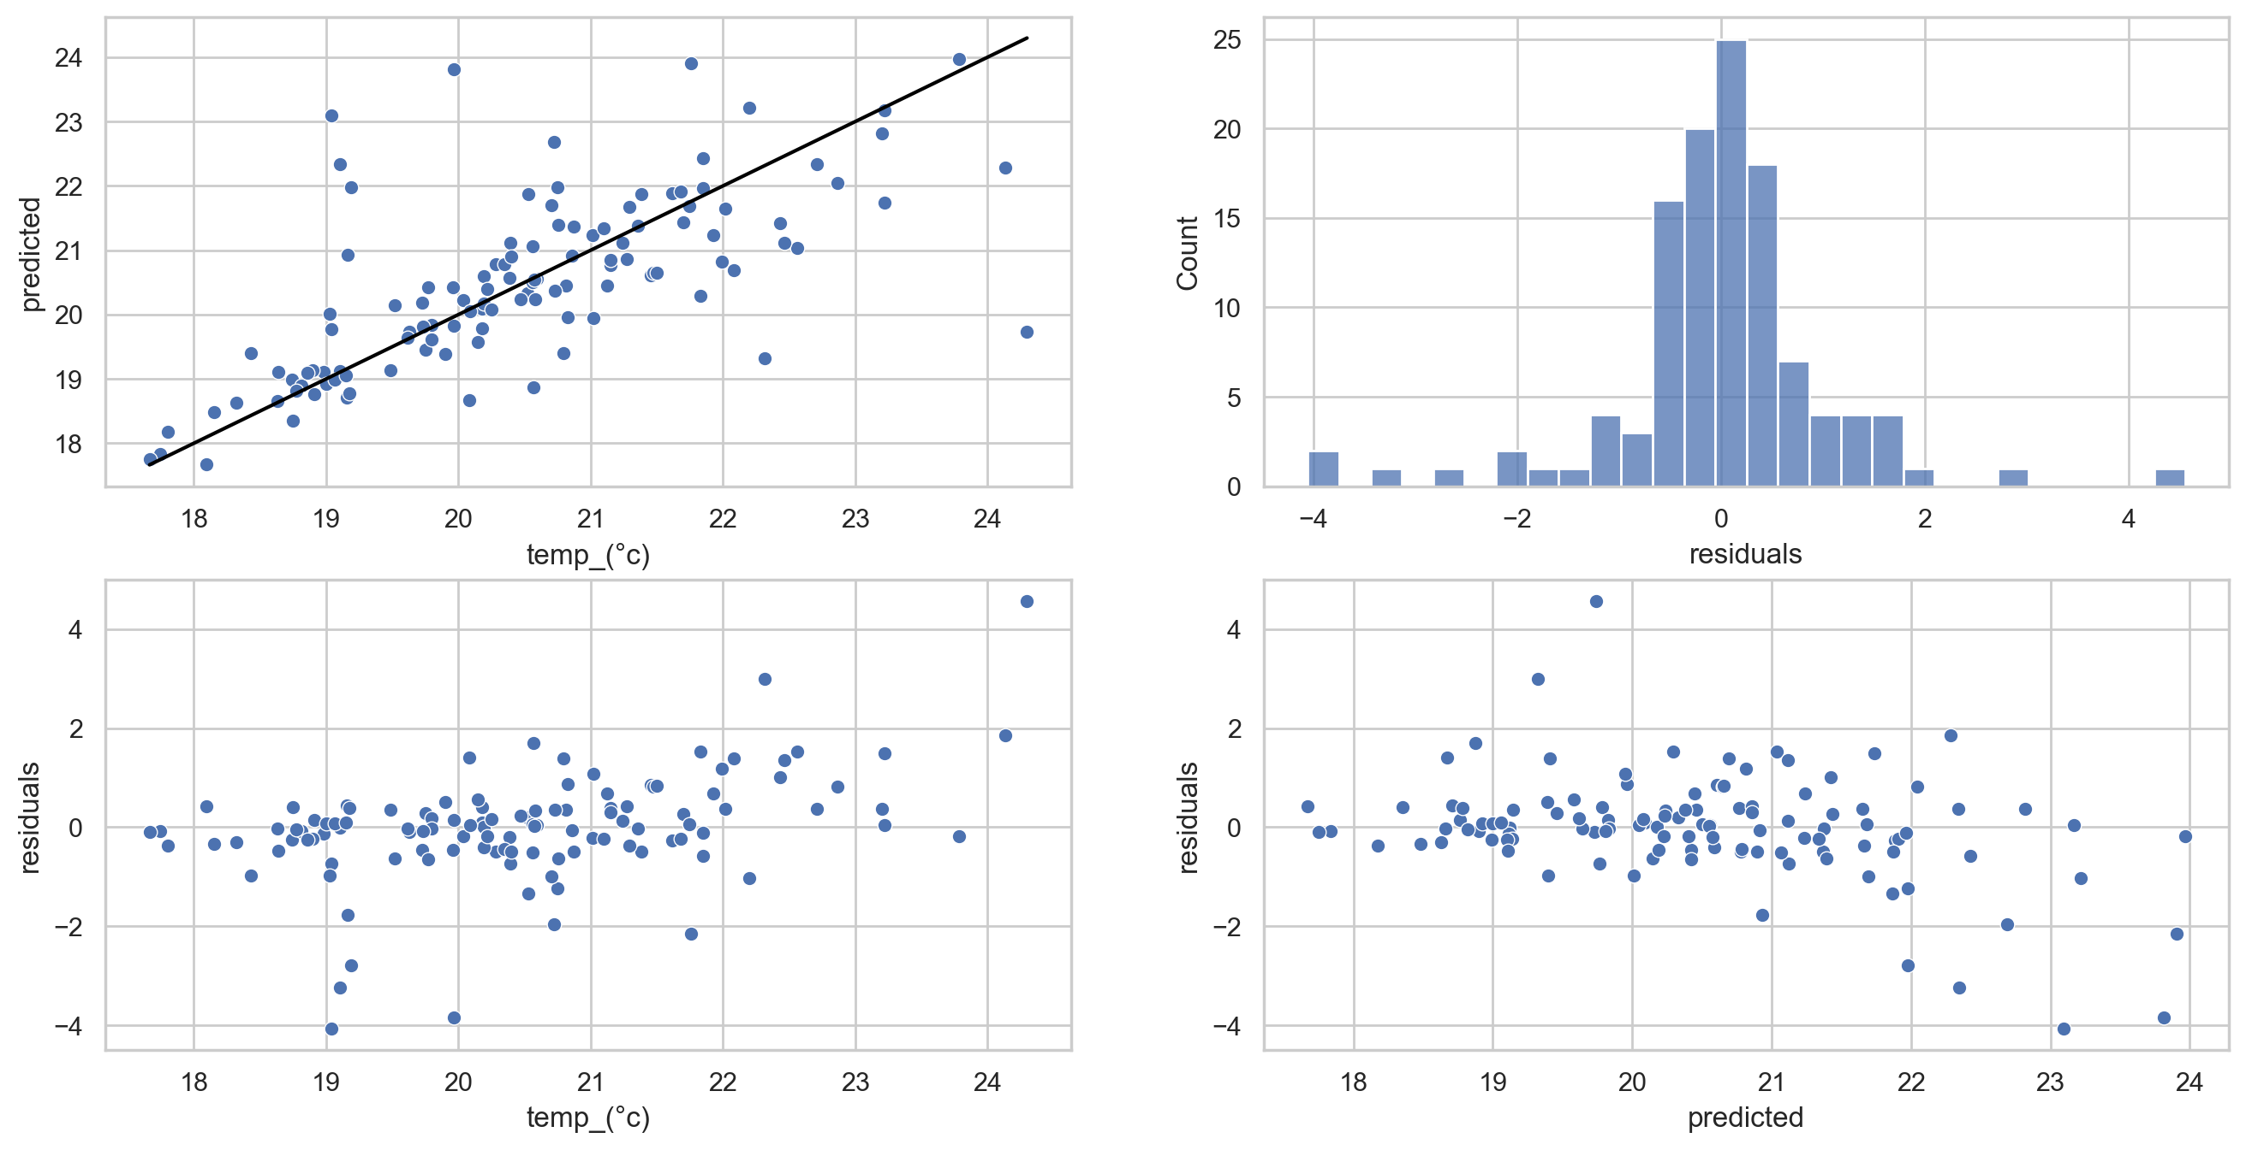
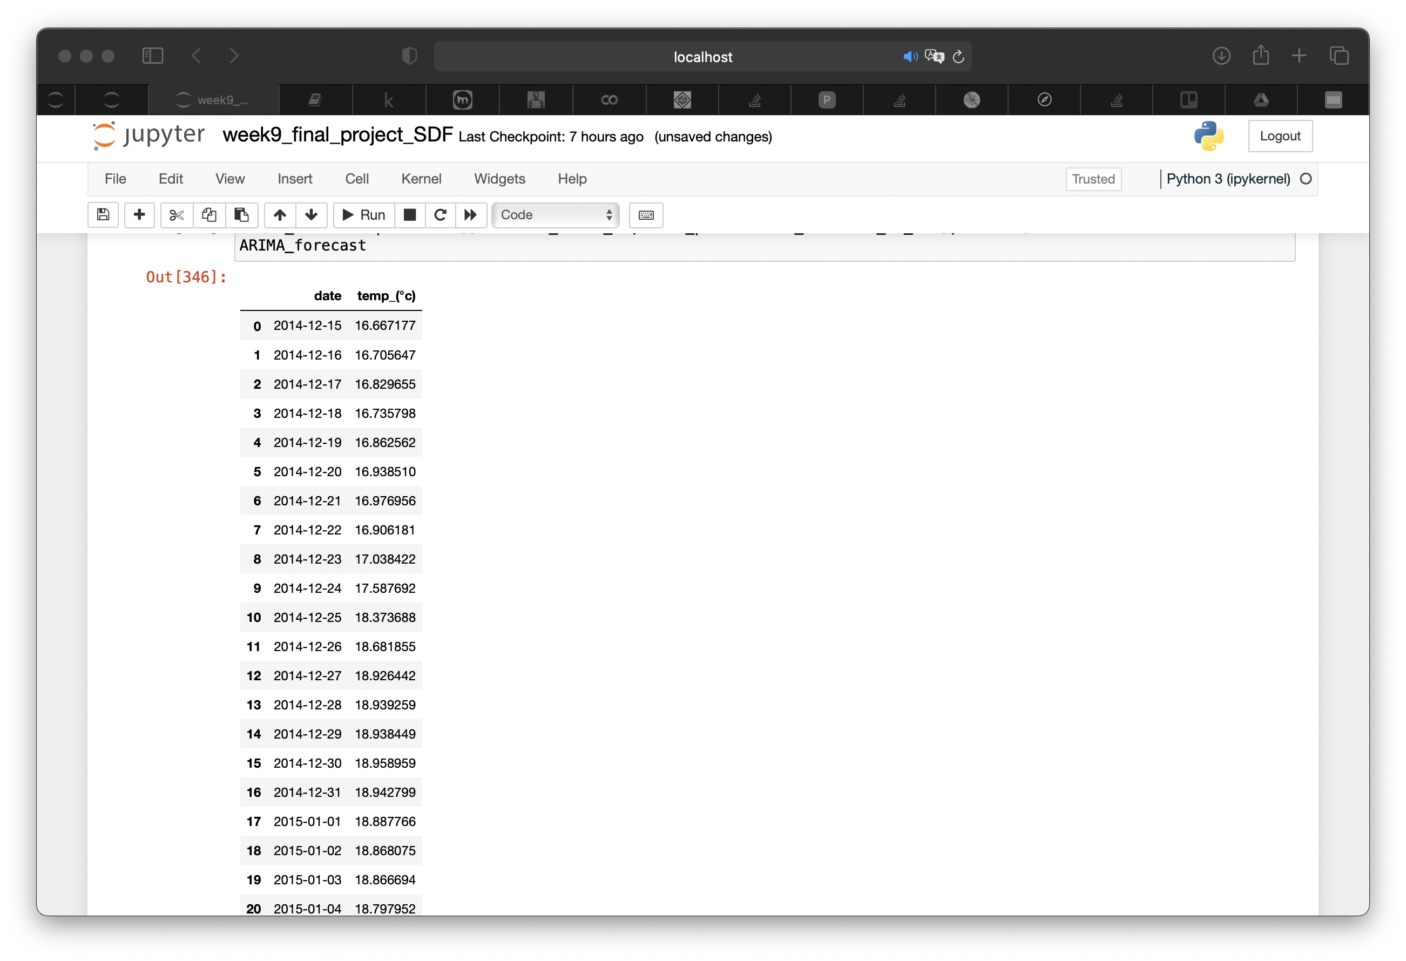
Analysis #2 = Time Series (TS)
ARIMA model predictions
Train set
Forecast: 30 days
Mean Absolute Scaled Error (MASE)
The MASE train of the ARIMA model is: 0.09
The MASE test of the ARIMA model is: 0.97

Slide 15
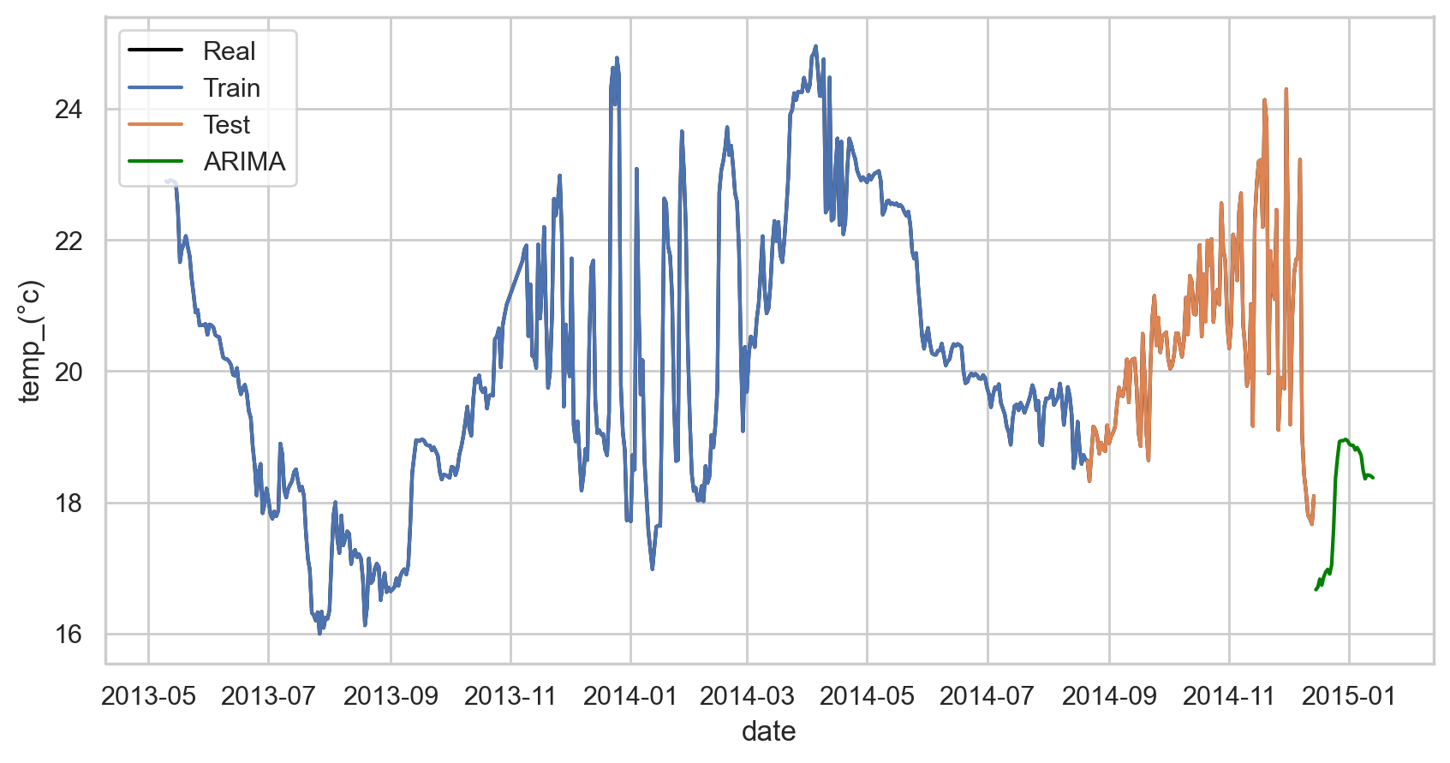
Analysis #2 = Time Series (TS)

Slide 16

Conclusions
If we consider the data as not TS:
Random forest is the best model to predict the underwater temperature
If we consider the data as TS:
The ARIMA model overfitting ( Real value == prediction)
The forecast using the ARIMA model is not the best bacuse of SEASONALITY (repeat every year)
…and Outlook:
Since the TS is SEASONAL try the SARIMA(p,d,q,P,D,Q,m) model

Slide 17
Thank you! Questions?!?

